Slide 1

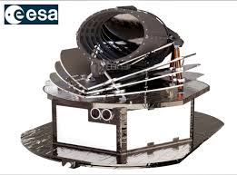
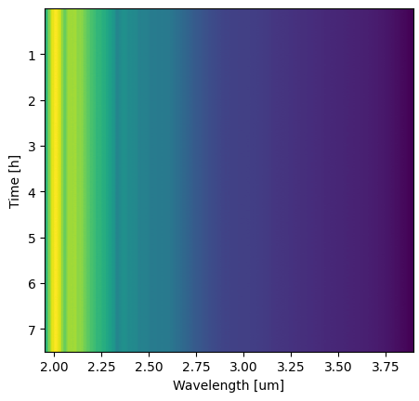
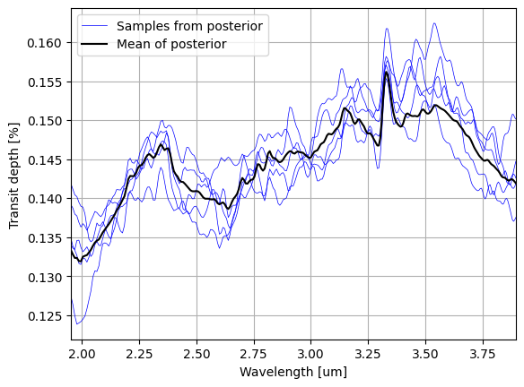
Input: raw detector readings
Preprocessed signal S(λ,t)
Transit depth D(λ)±σ(λ)
Output: submission
Preprocess
Bayesian Inference
Fudge

